Slide 1
RUMI AND SHAMS
Mihika Saxena

Slide 2
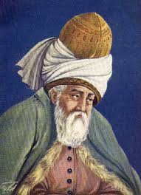
Jalal –ad- Din Muhammad Rumi
Sources: Google images

Slide 3
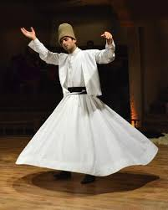
Whirling Dervishes
Sources: Google images

Slide 4
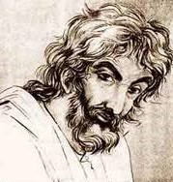
SHAMS TABRIZI
Sources: Google images

Slide 5
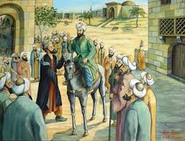
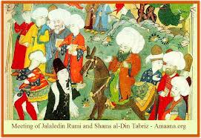
THE MEETING
OF RUMI AND SHAMS
Sources: Google images

Slide 6

INFLUENCE OF SHAMS
“ Why should I seek? Am the same as
he. His essence speaks through me.
I have been looking for myself! ”
“Shams-e-Tabriz :
you are either the light of god
Or god himself in human form.”
Sources: Google images

Slide 7
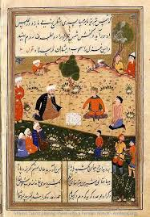
DIWAN-E-SHAMS-E-TABRIZI
Sources: Google images

Slide 8
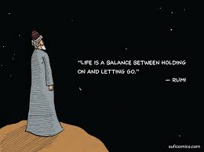
TEACHINGS OF RUMI
“Late, by myself, in the boat of myself
no light and no land anywhere,
cloud cover thick. I try to stay
just above the surface, yet I am already
under and living within the ocean.”
Sources: Google images

Slide 9

“ No matter how fast you run,
your shadow more than keeps up.
sometimes its in front!
But the shadow has been serving you
What hurts you blesses you
Darkness is your candle
Your boundaries are your quest. ”
Sources: Google images

Slide 10
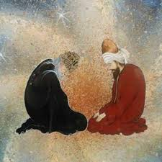
CONCLUSION
“ After meeting shams my father danced all day and sang all night. He had been an ascetic, now he became drunk in love. “
- Sultan Walled
Sources: Google images

